Slide 1

Review in Internal Audit: Core Business Process Cycles
This presentation delves into the fundamental core business process cycles: Procure-to-Pay (P2P), Order-to-Cash (O2C), and Record-to-Report (R2R). Understanding and optimizing these interconnected workflows are crucial for ensuring business continuity, financial health, and operational efficiency. We will explore each cycle in detail, highlighting their key steps, relevant Key Performance Indicators (KPIs), and the critical role of internal audit in reviewing and enhancing these processes.

Slide 2




Introduction to Core Business Process Cycles
Structured Workflows
Spanning Key Areas
Core business process cycles represent structured workflows essential for business continuity.
They span procurement, revenue generation, and financial reporting.
Interacting Cycles
Ensuring Optimization
These cycles interact with each other to provide a complete operational picture.
Optimizing them ensures cost control, revenue acceleration, and compliance.
Common Core Business Cycles
P2P
O2C
R2R
Procure-to-Pay: Acquire goods/services and pay suppliers.
Order-to-Cash: Fulfill customer orders and collect payment.
Record-to-Report: Capture transactions and produce Financial Reports.

Slide 3
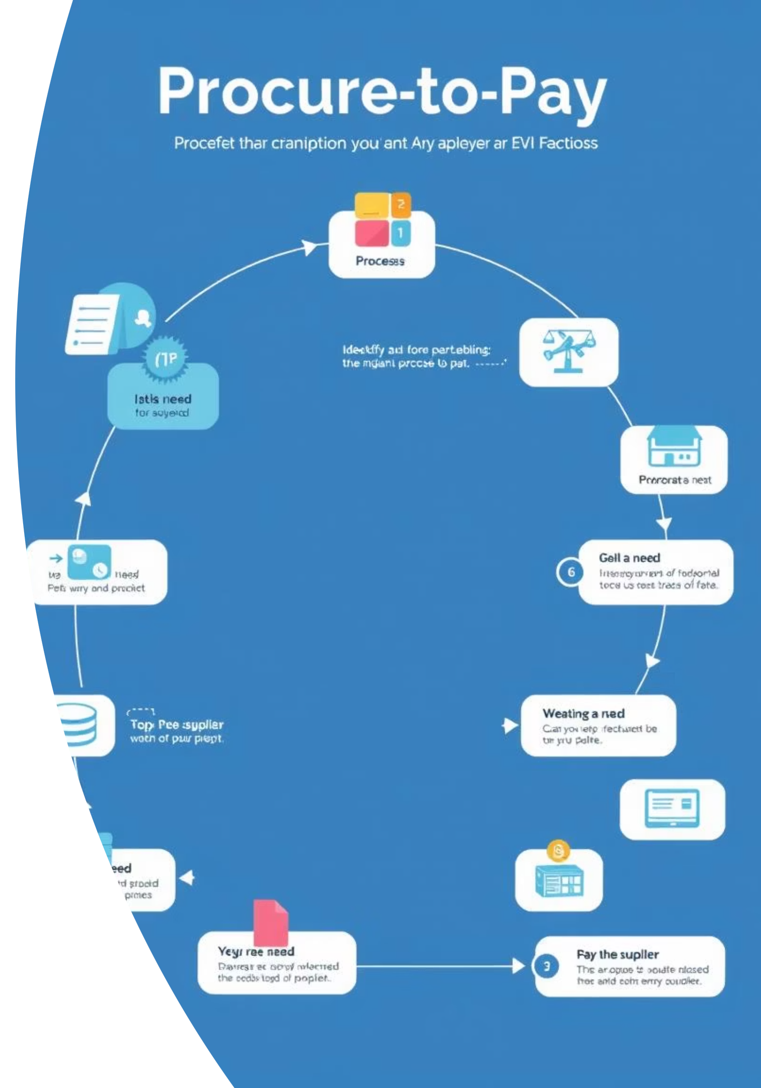
Procure to Pay (P2P)
The Procure-to-Pay (P2P) cycle covers all activities from identifying a need to paying the supplier. It is a critical process for managing expenditures and ensuring the efficient acquisition of goods and services.
Detailed Steps:
Identify and approve procurement requirements.
Select qualified suppliers through evaluation.
Create and approve purchase orders (POs).
Receive goods or services with quality checks.
Match invoices with POs and goods receipts.
Approve and execute payment to suppliers.
Key Performance Indicators (KPIs):
Cycle time
Purchase cost savings
Supplier performance index

Slide 4
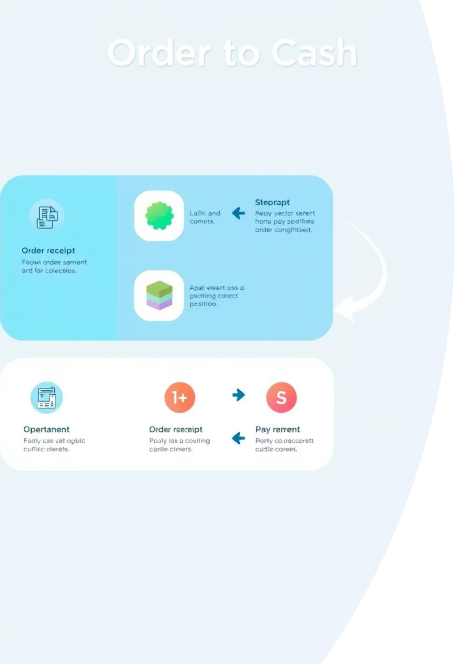
Order to Cash (O2C)
The Order-to-Cash (O2C) cycle encompasses all steps from receiving a customer order to collecting payment. This cycle is vital for revenue generation and customer satisfaction.
Detailed Steps:
Order entry and confirmation.
Credit approval to minimize risk.
Order fulfillment (picking, packing, and shipping).
Delivery confirmation.
Invoice generation and delivery to customer.
Payment receipt and allocation.
Key Performance Indicators (KPIs):
Days Sales Outstanding (DSO)
Order accuracy rate
Customer satisfaction score

Slide 5
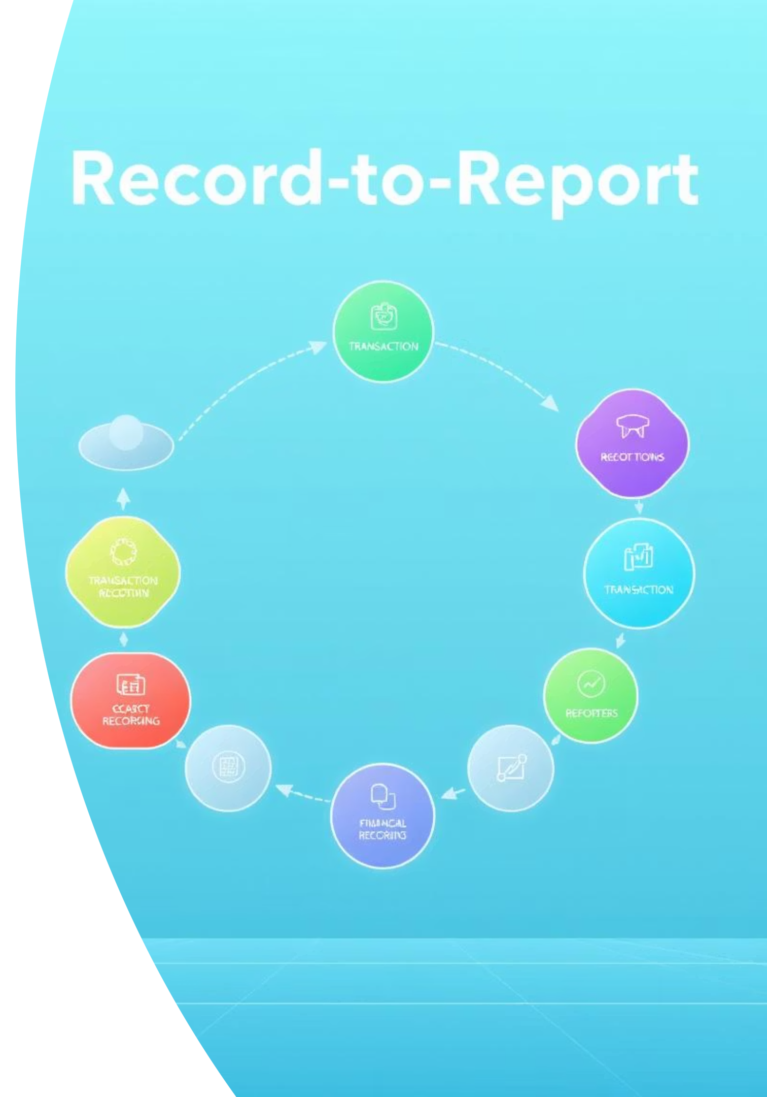
Record to Report (R2R)
The Record-to-Report (R2R) cycle covers the entire accounting cycle, from recording individual transactions to producing final financial reports. It is fundamental for financial transparency and decision-making.
Key Performance Indicators (KPIs):
Reporting accuracy
Cycle time
Compliance score

Slide 6



Relationship Between P2P, O2C, and R2R
These three core business cycles are deeply interconnected and form the backbone of an organization's operational and financial health. Their seamless integration is crucial for effective business performance management.
P2P: Procurement
O2C: Revenue Generation
R2R: Financial Insights
Ensures that necessary materials and services are procured for operations.
Manages revenue generation from customer transactions.
Consolidates data from both P2P and O2C to produce comprehensive financial insights.
Together, these cycles provide a holistic view of business performance, enabling informed strategic decisions and ensuring compliance with financial regulations.

Slide 7
Procure-to-Pay (P2P) Review by Internal Audit
Internal audit plays a crucial role in ensuring the efficiency, compliance, and integrity of the P2P cycle. Key areas of review include:
Planning & Risk Assessment
Process Mapping
Vendor Master Audit
Identify high-risk areas like non-PO purchases, duplicate vendors, GST/TDS errors.
Document the full flow: Requisition → PO → Goods Receipt → Invoice → Payment.
Check KYC, GSTIN, bank details, MSME classification; detect duplicates or shell vendors.
PO Compliance
Three-Way Match Testing
Invoice & Payment Testing
Verify approvals, competitive bidding, correct tax clauses.
PO vs GRN vs Invoice for quantity, price, tax codes.
Sample for GST/TDS accuracy, timely MSME payments, early-payment discounts.
Exception Reporting
Flag non-PO transactions, payments without GRNs, breaches of approval limits.

Slide 8









Order-to-Cash (O2C) Review by Internal Audit
Internal audit's review of the O2C cycle focuses on optimizing revenue recognition, managing credit risk, and enhancing customer satisfaction. Key audit areas include:
Order Management Controls
Credit Risk Management
Validate order entry accuracy, pricing, and terms.
Review credit approval process and limits.
Fulfillment & Shipping
Invoicing Accuracy
Match dispatch records to orders; check timeliness and completeness.
Ensure invoices match orders and delivery notes; verify tax compliance.
Accounts Receivable Testing
Collections & Cash Application
Ageing analysis, bad debt provisioning, write-off approvals.
Trace receipts for unapplied cash.
KPI Review
Red Flag Analysis
Days Sales Outstanding (DSO), dispute rates, order cycle time; investigate anomalies.
Excessive discounts, frequent returns, manual overrides, data silos.

Slide 9
Record-to-Report (R2R) Review by Internal Audit
The R2R cycle is crucial for accurate financial reporting. Internal audit ensures the integrity of financial statements and compliance with accounting standards. Key audit considerations include:
General Ledger & Sub-Ledger Reconciliation
Journal Entry Controls
Test completeness and accuracy of postings.
Review documentation, and approvals, supporting segregation of duties.
Period Close Process
Financial Statement Accuracy
Assess timeliness, accuracy of accruals, provisions, and adjustments.
Cross-check trial balance to statements; perform variance analysis.
Compliance & System Controls
Automation
Verify adherence to accounting standards, tax laws, regulatory, and disclosure norms.
Evaluate ERP configurations, access rights, and change management.
Audit Trail & Documentation
Analytical Review
Ensure all entries and reports are supported for internal/external audit readiness.
Trend and ratio analysis to detect unusual fluctuations.

Slide 10
Summary & Internal Audit's Role
The P2P, O2C, and R2R cycles are the essential pillars of operational excellence. Their effective management is critical for business success.
Operational Excellence
Process Automation
The three cycles are essential pillars of operational excellence.
Enhancements in process automation can reduce errors and speed up workflows.
KPI Monitoring
ERP Integration
Monitoring KPIs helps sustain performance improvements.
Integration of these processes in ERP systems ensures real-time visibility.
Internal Audit's Role Across All Three Cycles:
Test control design (are controls adequate?) and operating effectiveness (are they working as intended?).
Identify process gaps and recommend automation or policy changes.
Provide management with assurance on compliance, efficiency, and fraud prevention.

